Slide 1


Slide 2
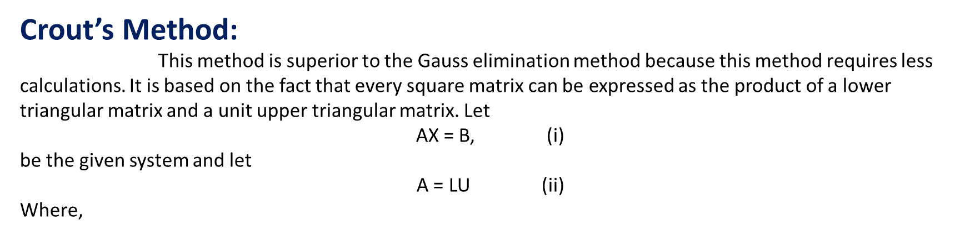


Numerical Methods
National University of Science and Technology, Islamabad

Slide 3

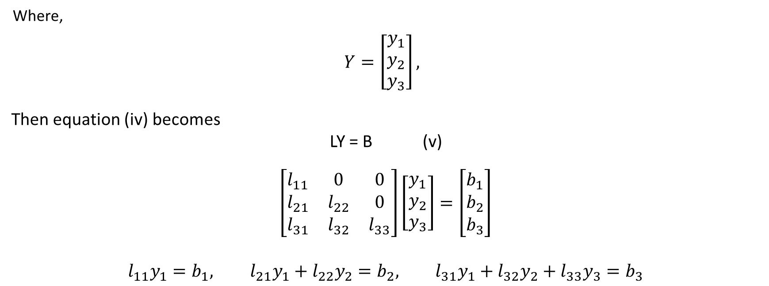
Numerical Methods
National University of Science and Technology, Islamabad

Slide 4
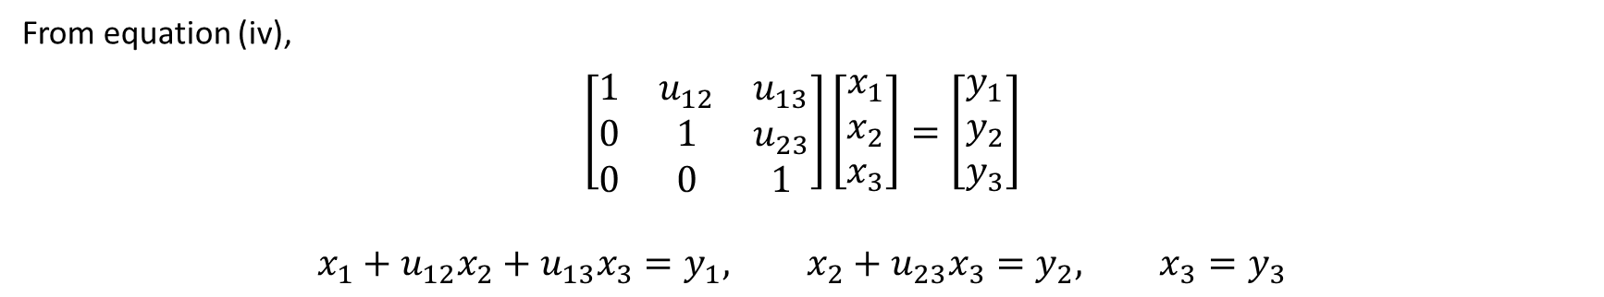
Numerical Methods
National University of Science and Technology, Islamabad

Slide 5
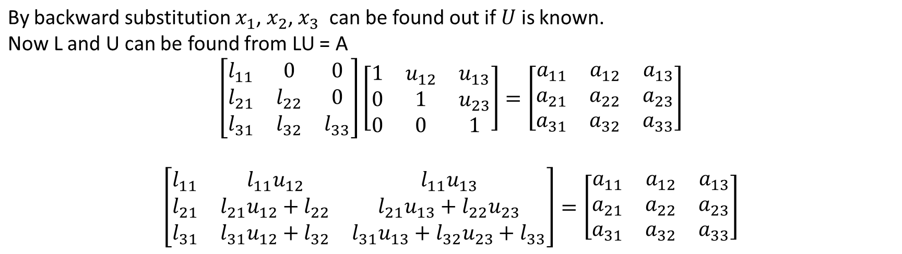
Numerical Methods
National University of Science and Technology, Islamabad

Slide 6
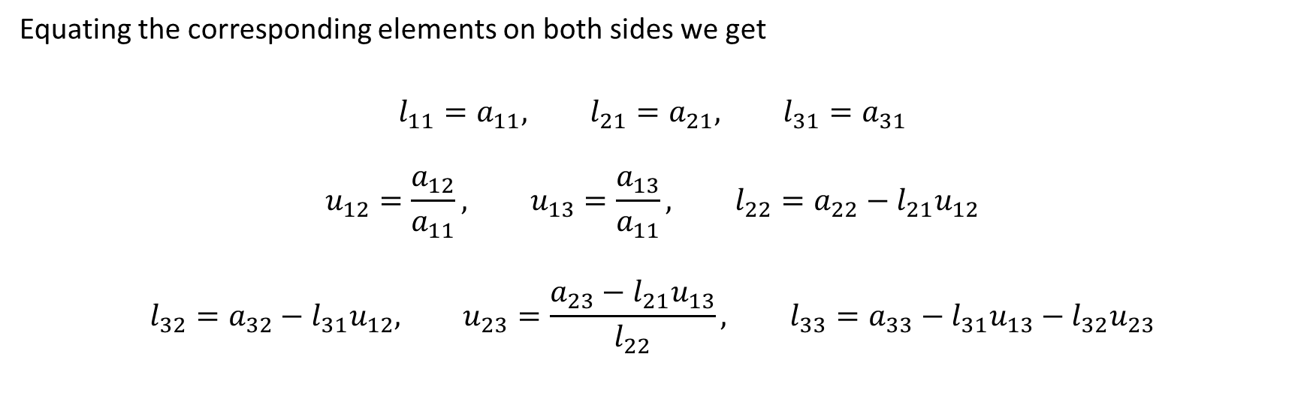
Numerical Methods
National University of Science and Technology, Islamabad

Slide 7
Numerical Methods
NOTE: The Crout’s matrix decomposition algorithm differs slightly from the Doulittle’s method. Doulittle's method returns a unit lower triangular matrix and an upper triangular matrix, while the Crout’s method returns a lower triangular matrix and a unit upper triangular matrix.
National University of Science and Technology, Islamabad

Slide 8
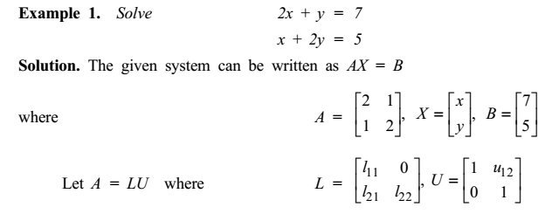
Numerical Methods
National University of Science and Technology, Islamabad

Slide 9
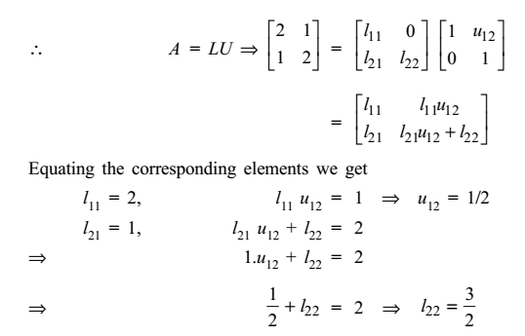
Numerical Methods
National University of Science and Technology, Islamabad

Slide 10
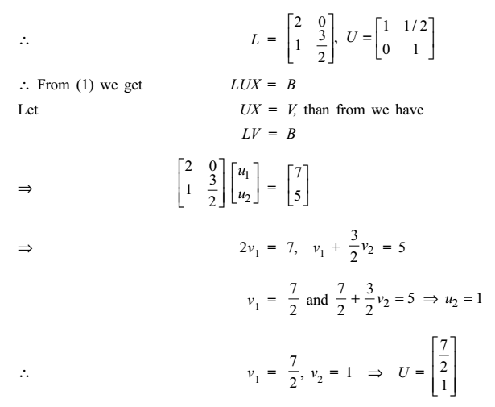
Numerical Methods
National University of Science and Technology, Islamabad

Slide 11
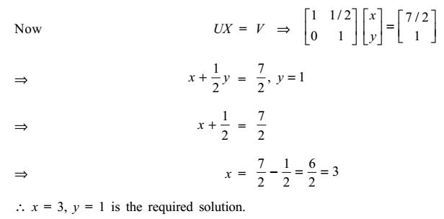
Numerical Methods
National University of Science and Technology, Islamabad

Slide 12


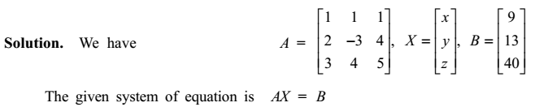
Numerical Methods
National University of Science and Technology, Islamabad

Slide 13
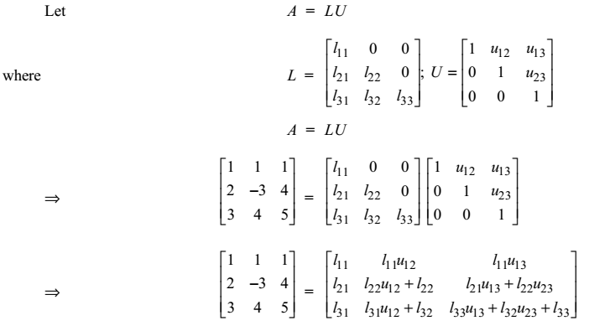
Numerical Methods
National University of Science and Technology, Islamabad

Slide 14
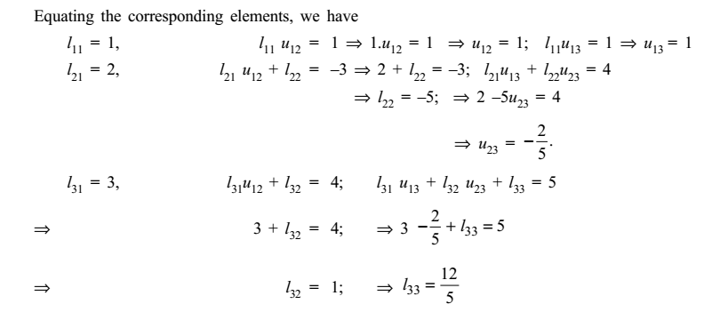
Numerical Methods
National University of Science and Technology, Islamabad

Slide 15
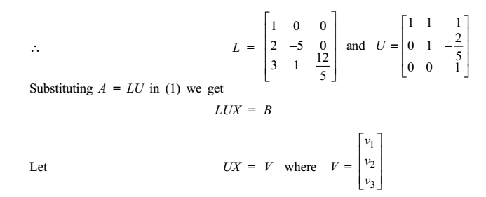
Numerical Methods
National University of Science and Technology, Islamabad

Slide 16
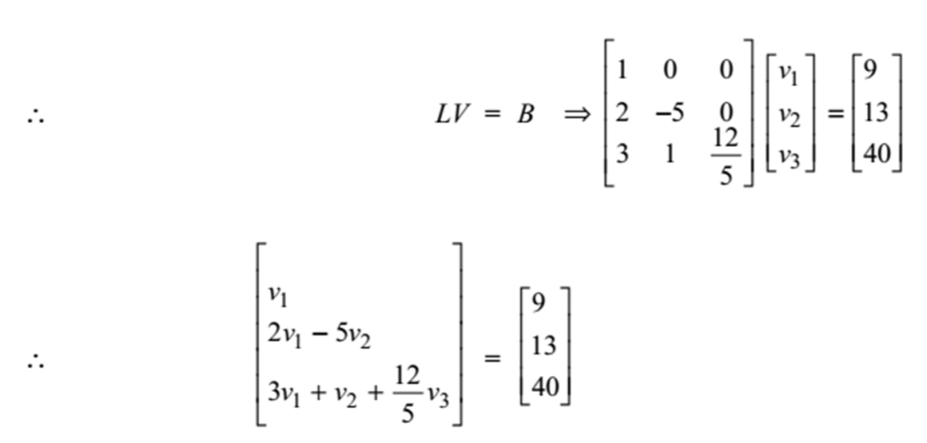
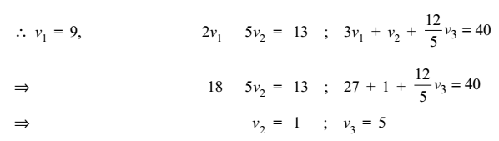
Numerical Methods
National University of Science and Technology, Islamabad

Slide 17
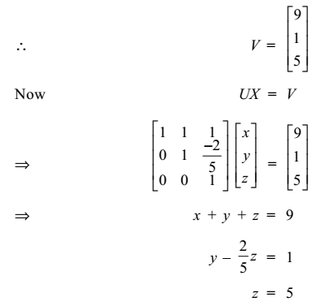

Numerical Methods
National University of Science and Technology, Islamabad

Slide 18
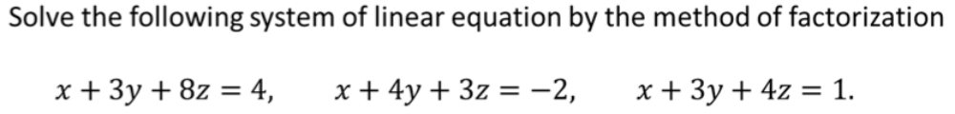
Numerical Methods
Class Task
National University of Science and Technology, Islamabad

Slide 19
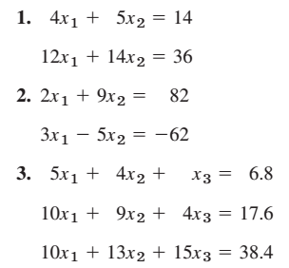
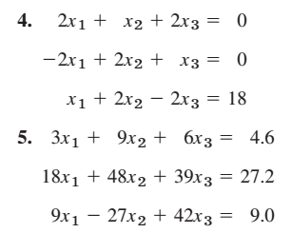
Numerical Methods
Solve the following system of linear equations by Crout’s Method
National University of Science and Technology, Islamabad

Slide 20
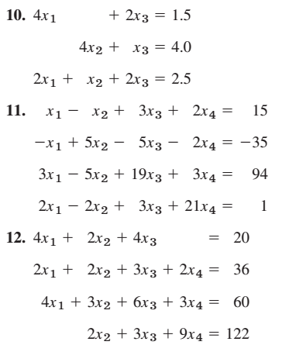
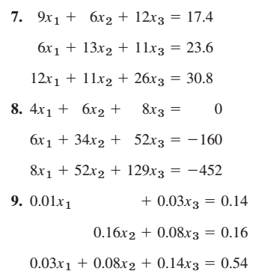
Numerical Methods
Solve the following system of linear equations by Crout’s Method
National University of Science and Technology, Islamabad

